Slide 1
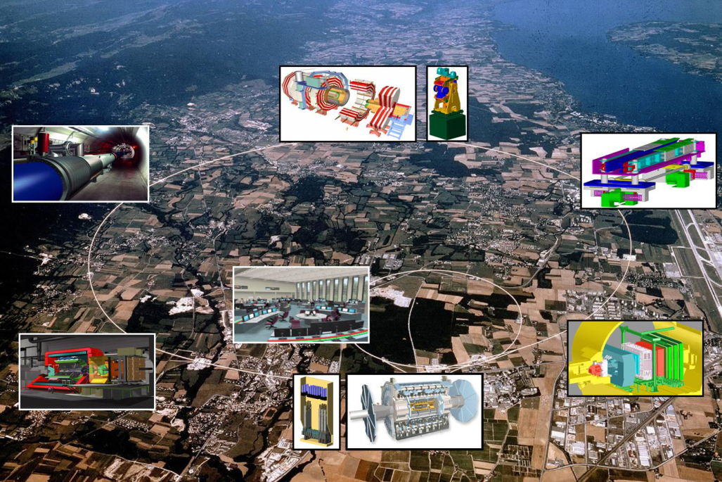
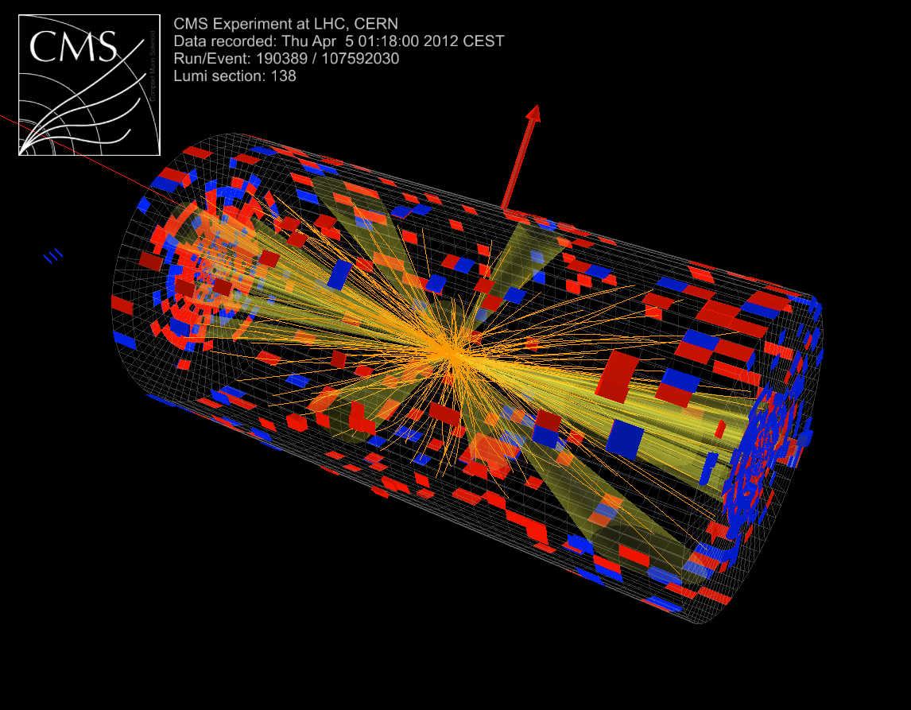
Sterile Neutrinos Searches at Proton Colliders
Kechen Wang (王科臣)
Wuhan University of Technology (武汉理工大学)
Particle Physics Workshop
SYSU, Guangzhou, Jan. 22, 2019
Based on [JHEP 1810 (2018) 067; PRD 95 (2017) 115020, CPC 41 (2017) 103103,
PRD 94 (2016) 013005 ]
1 / 22

Slide 2
Introduction
3l+MET @ HL-LHC
2l+2j @ HL-LHC, SppC/FCC-hh
Summary
Outline
Introduction
• Sterile Neutrinos Productions @ pp colliders
3l+MET @ HL-LHC
[C. Dib, C. S. Kim, K. Wang and J. Zhang, PRD 95 (2017) 115020, CPC 41 (2017) 103103, PRD 94 (2016) 013005]
2l+2j @ HL-LHC & SppC/FCC-hh
[S. Antusch, E. Cazzato, O. Fischer, A. Hammad and K. Wang, JHEP 1810 (2018) 067]
Summary
2 / 22

Slide 3
Introduction
3l+MET @ HL-LHC
2l+2j @ HL-LHC & SppC/FCC-hh
Summary
Sterile Neutrino Productions @ pp Colliders
almost unobserved
(l⁺l⁻ or l±+MET suffer from huge BG)
(no resonance enhancement)
Mostly studied
(important for m_{N} < 1 TeV)
More important for m_{N} > 1 TeV
3 / 22

Slide 4
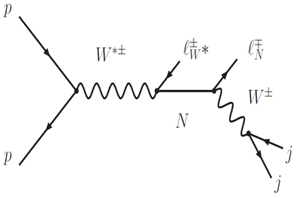
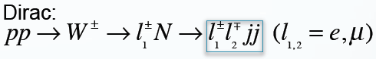
Introduction
3l+MET @ HL-LHC
2l+2j @ HL-LHC & SppC/FCC-hh
Summary
Main Search Channels @ pp Colliders
3l + MET
→ better for Majorana or Dirac N with m_{N} < m_{W}
m_{N} < m_{W}: [1504.02470]
m_{N} > m_{W}: [0809.2096,
0910.2720, 1112.6419 ...]
LNV:
non-trival ←
flavor of ν undetectable
distinguishable?
LNC:
[0809.2096, 1509.05981]
2l + 2j
need well isolated energetic 2 jets;
→ better for m_{N} > m_{W}
[CMS: 1207.6079, 1501.05566]
[ATLAS-CONF-2012-139]
Majorana:
4 / 22

Slide 5
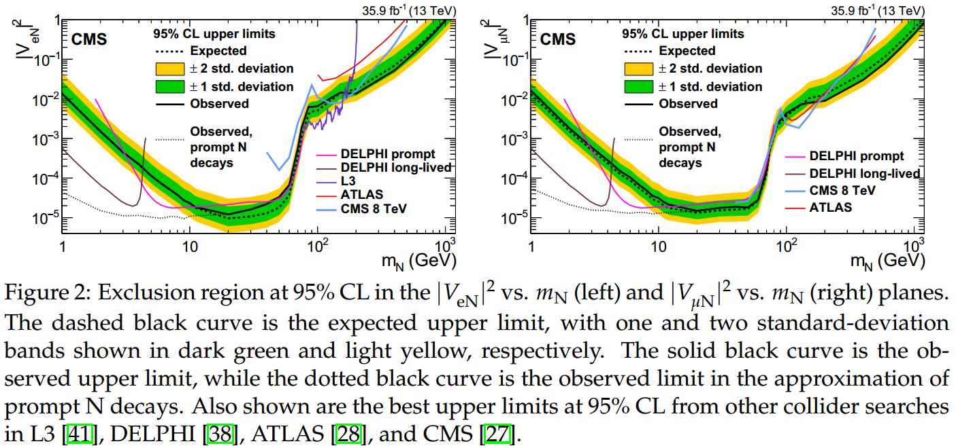
Introduction
3l+MET @ HL-LHC
2l+2j @ HL-LHC & SppC/FCC-hh
Summary
Collider Limits on Sterile Neutrinos
[LHC, CMS experiment: Phys.Rev.Lett. 120 (2018) no.22, 221801,
“Search for heavy neutral leptons in events with three charged leptons in proton-proton collisions at 13 TeV” ]
3l + MET
5 / 22
Notes:
Majorana N;
three charged leptons in any combination of electrons and muons, excluding those events containing three leptons of the same charge;
To extract values of |VeN|^2 and |VmN|^2 separately, the results for both the low- and high-mass regions are obtained for events with >= 2 electrons or >= 2 muons, respectively;
limits on |VeN|^2 and |VmN|^2 separately, while assuming other matrix elements to be 0.

Slide 6
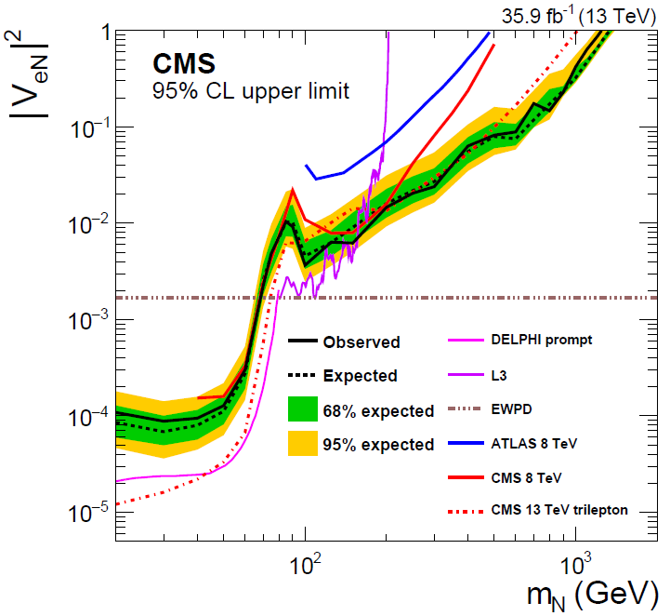
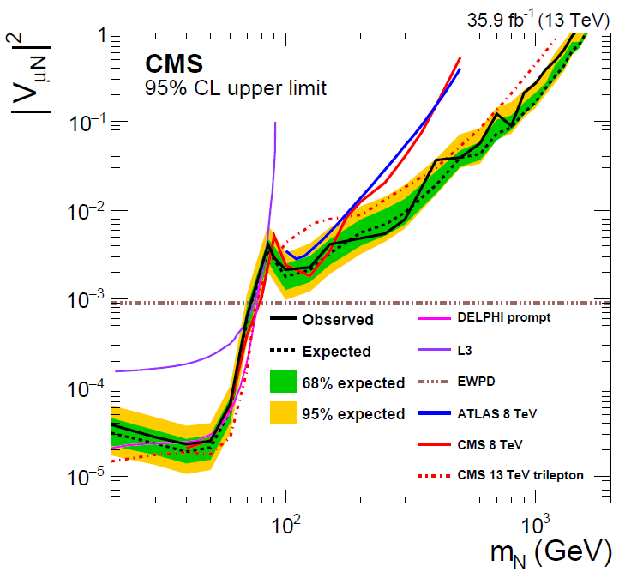
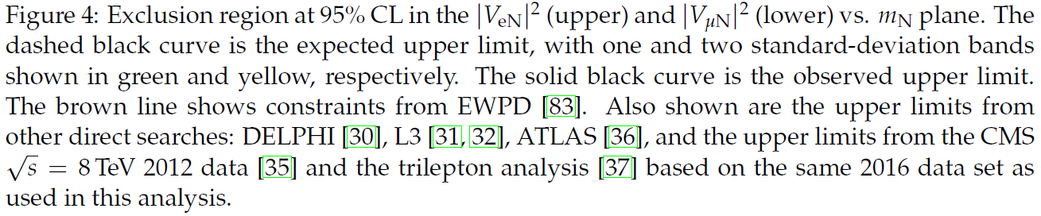
Introduction
3l+MET @ HL-LHC
2l+2j @ HL-LHC & SppC/FCC-hh
Summary
Collider Limits on Sterile Neutrinos
[LHC, CMS experiment: hep-ex/1806.10905, CMS-EXO-17-028,
“Search for heavy Majorana neutrinos in same-sign dilepton channels in proton-proton collisions at 13 TeV” ]
2l(SS) + ≥ 1 j
6 / 22
Notes:
For low-mass signals the trilepton analysis is more sensitive, since it has both fewer backgrounds from misidentified leptons and higher signal efficiency.

Slide 7
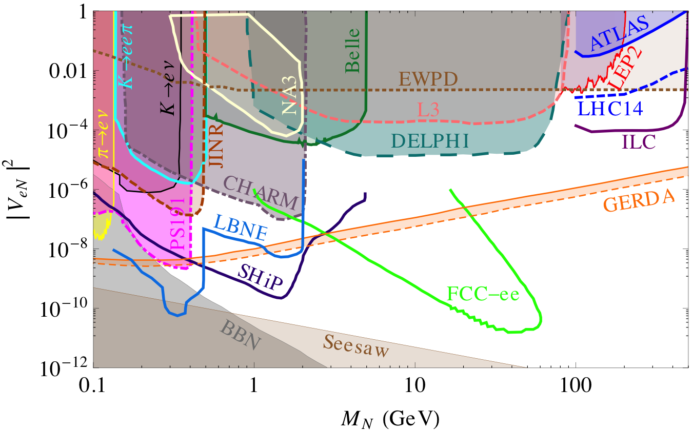
Introduction
3l+MET @ HL-LHC
2l+2j @ HL-LHC & SppC/FCC-hh
Summary
Global Constraints
from [Deppisch, Dev and Pilaftsis, New J. Phys. 17 (2015) 085019]
m_{N}: 0.1 ~ 500 GeV
7 / 22

Slide 8
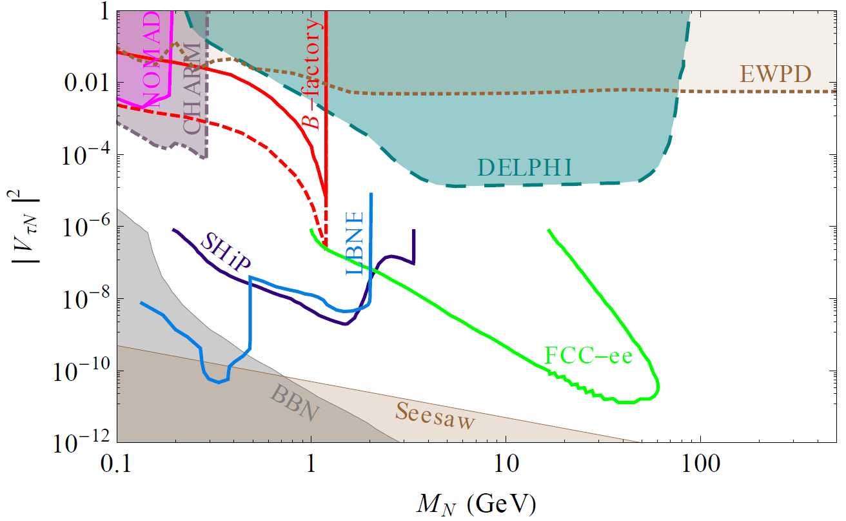
Introduction
3l+MET @ HL-LHC
2l+2j @ HL-LHC & SppC/FCC-hh
Summary
Global Constraints
from [Deppisch, Dev and Pilaftsis, New J. Phys. 17 (2015) 085019]
m_{N}: 0.1 ~ 500 GeV
[Z.Phys. C74 (1997) 57-71, CERN-PPE-96-195]
8 / 22

Slide 9
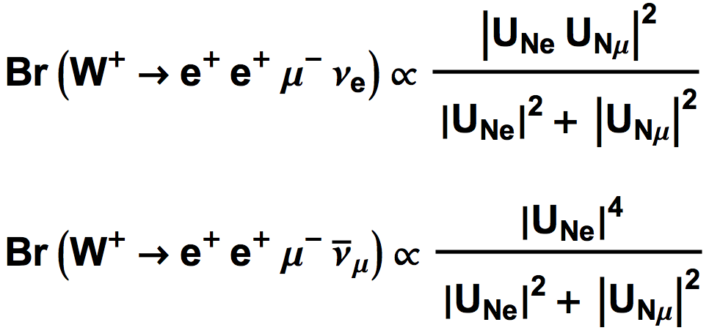
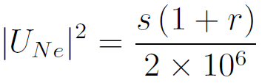
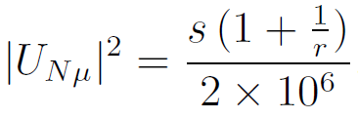
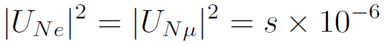
Introduction
3l+MET @ HL-LHC
2l+2j @ HL-LHC & SppC/FCC-hh
Summary
Production Rates
3l + MET with no-OSSF lepton pairs
LNC
via Majorana or Dirac N
LNV
via Majorana N only
Scale factors for different tri-lepton states
normalization factor
 | Dirac (LNC) | Majorana (LNC+LNV)
 | s | s (1 + r )
 | s
disparity factor
when r = 1,
→ When r >> 1, or << 1, Dirac vs. Majorana via production rates,
details see [Phys. Rev. D 94 (2016) 013005 ]
9 / 22

Slide 10
Introduction
3l+MET @ HL-LHC
2l+2j @ HL-LHC & SppC/FCC-hh
Summary
Collider Simulation
Simplified model with assumptions:
Only 1 generation of sterile neutrinos is within experimental reach;
U_{Nτ} = 0;
3 free parameters: m_{N}, U_{Ne}, U_{Nμ}, Dirac/Majorana.
Simulation
MadGraph (jet matching up to 2 extra partons) + PYTHIA + Delphes
Signal:
3l + MET with no OSSF lepton pairs
e⁺ e⁺ μ⁻ / μ⁺ μ⁺ e⁻ / e⁻ e⁻ μ⁺ / μ⁻ μ⁻ e⁺ + MET.
SM backgrounds:
→ Leptonic τ decay:
WZ -> (l ν) (τ τ) -> 3 l + MET
→ Fake leptons from jets containing heavy-flavor mesons:
γ*/Z+jets: γ*/Z (-> τ τ ) + a 3rd faked lepton
t tBar+jets: prompt decay of t tBar + a 3rd fake lepton
10 / 22

Slide 11
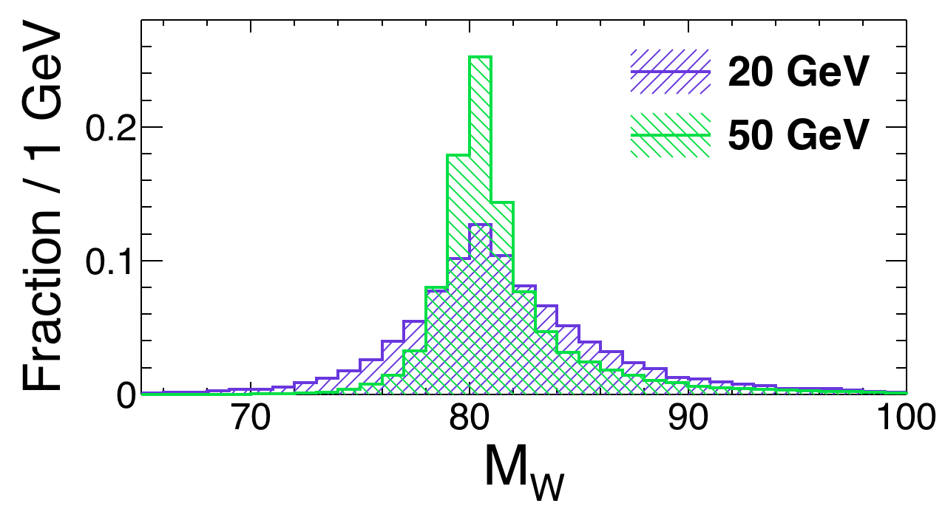
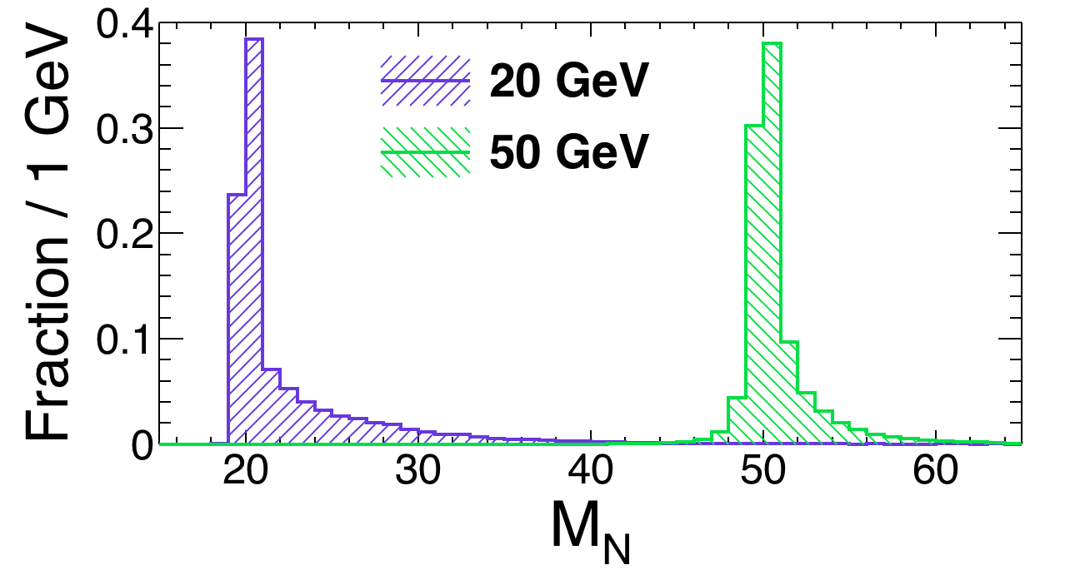
Introduction
3l+MET @ HL-LHC
2l+2j @ HL-LHC & SppC/FCC-hh
Summary
Search Strategy
→ Selecting 3 leptons & veto b-jets;
→ Identifying correct lepton from N & calculating p_{z,ν}
Constructing various observables
→ Input observables to perform MVA-BDT analysis
← by minimizing the
11 / 22

Slide 12
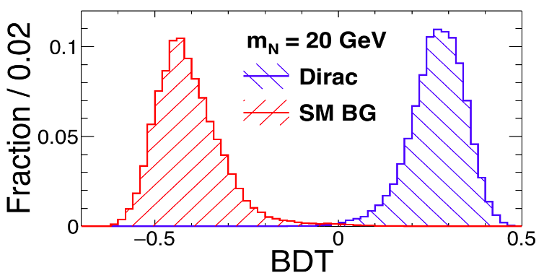
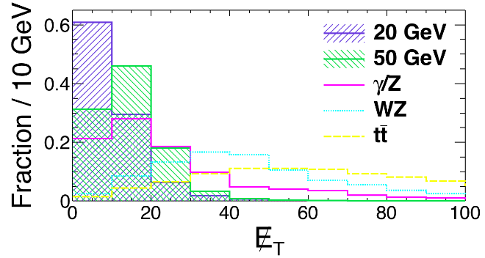
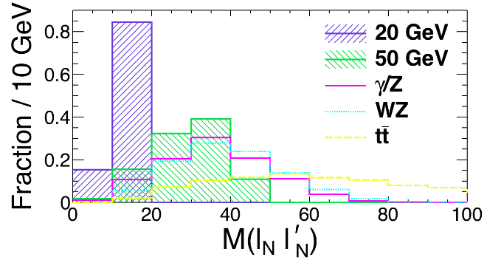
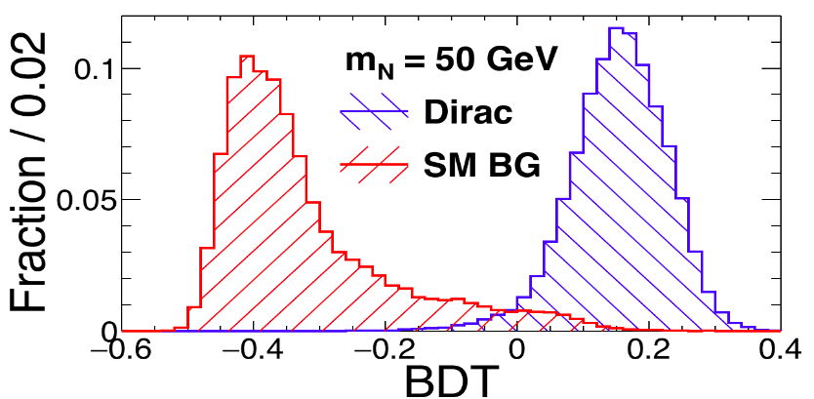
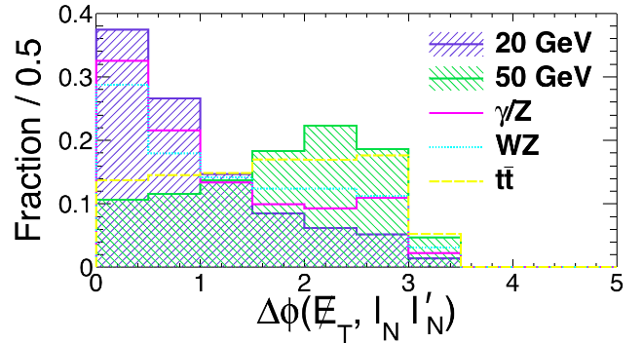
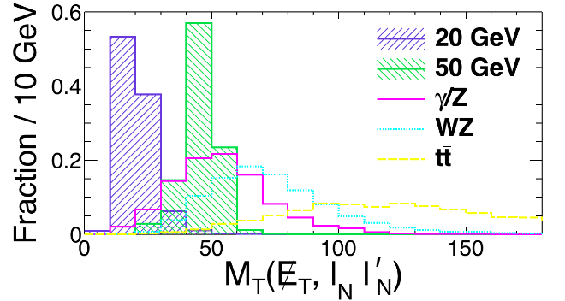
Introduction
3l+MET @ HL-LHC
2l+2j @ HL-LHC & SppC/FCC-hh
Summary
BDT Analysis
Input observables for BDT:
→ MET, H_{T};
→ M(leps), Δφ(lep, lep);
→ M_{T}(met, lep(s)), Δφ(met, lep(s));
BDT from TMVA package
Some observables for Dirac Signal & Backgrounds
12 / 22

Slide 13
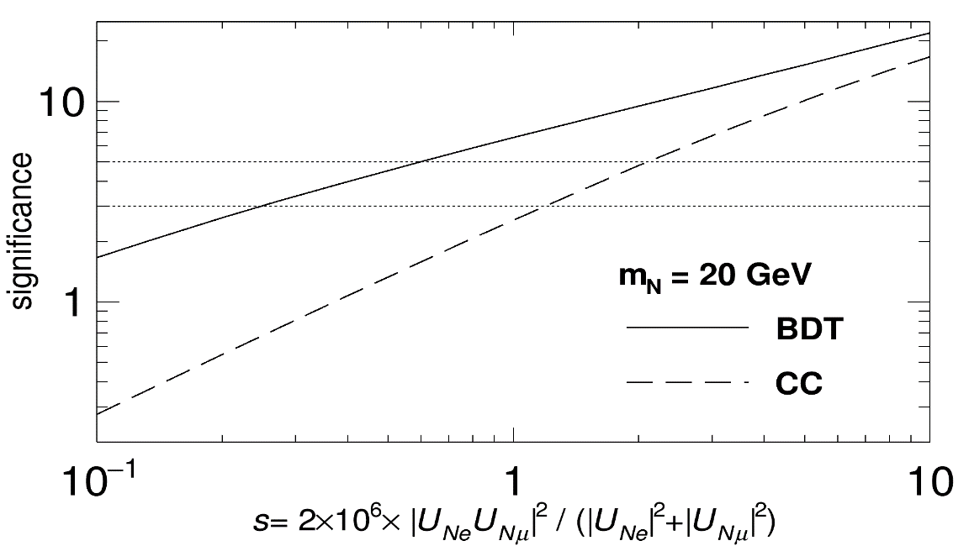
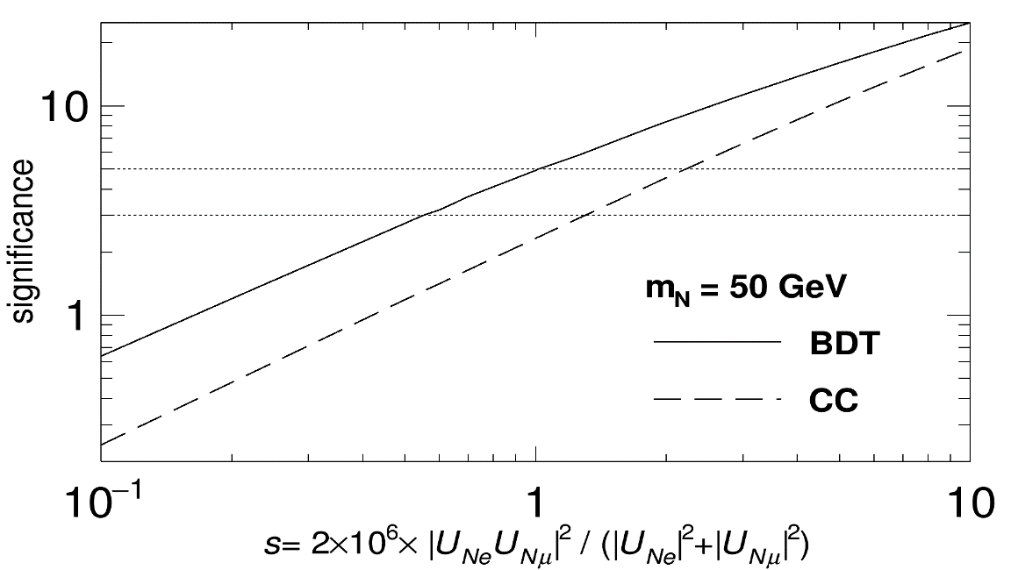
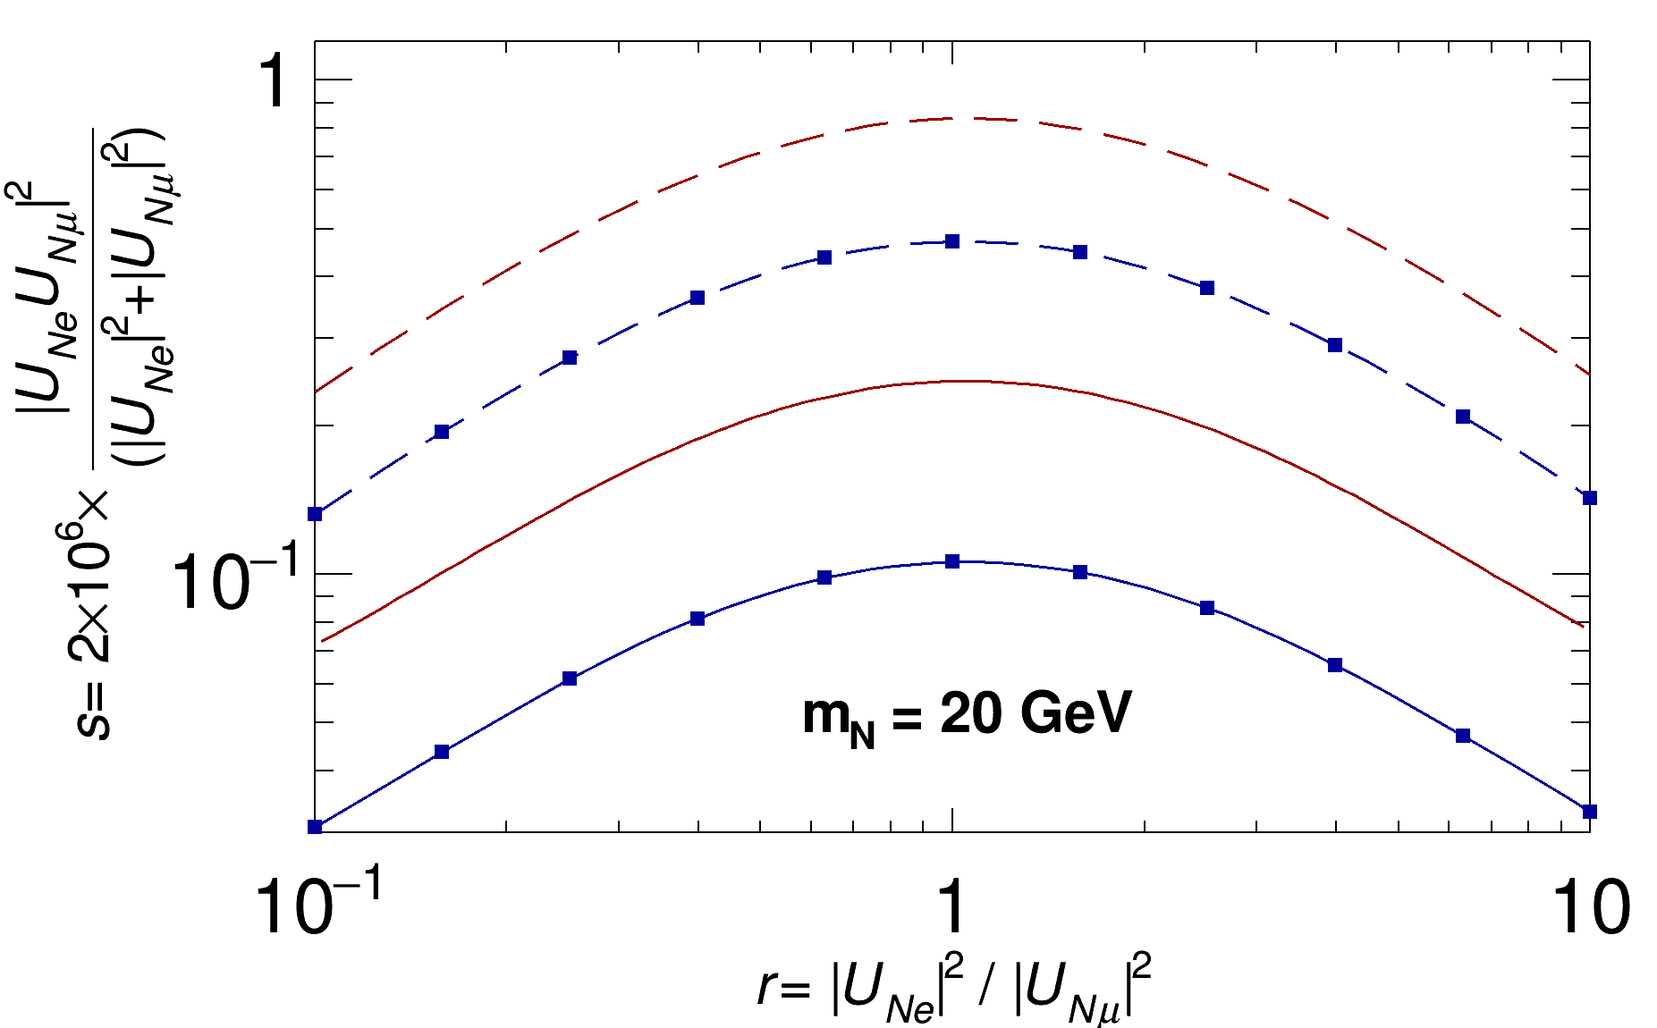
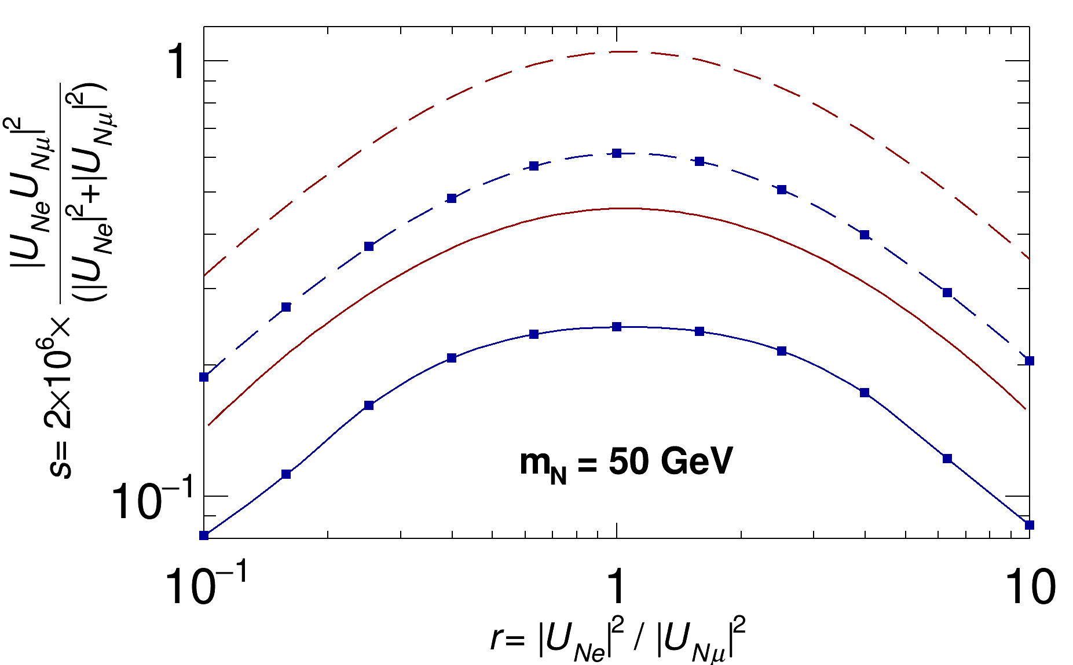
Introduction
3l+MET @ HL-LHC
2l+2j @ HL-LHC & SppC/FCC-hh
Summary
Discovering/Exclusion Limits
Dirac N
0.25
0.55
0.55
1.02
5σ
5σ
3σ
3σ
Majorana N
when r = 1,
5σ CC
0.46
0.24
3σ CC
0.11
0.25
0.08
0.16
5σ BDT
0.03
0.09
3σ BDT
13 / 22

Slide 14
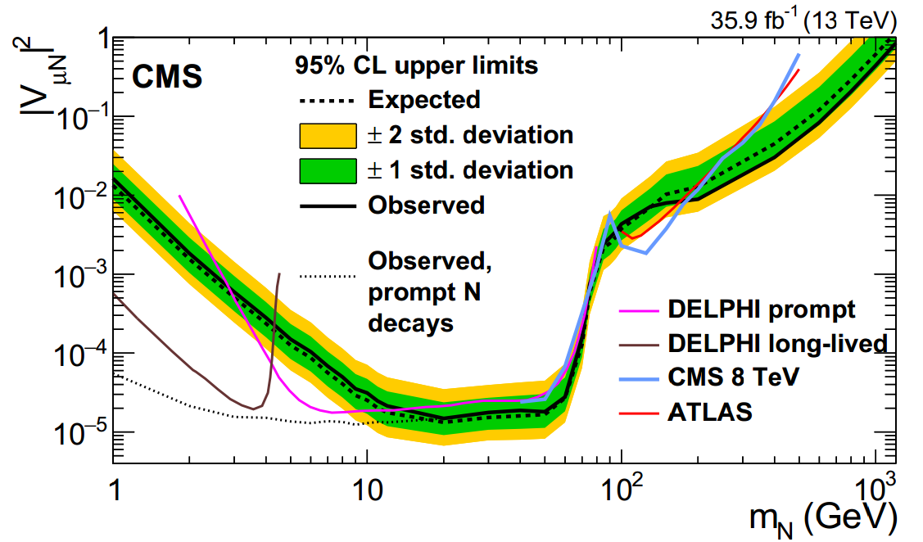
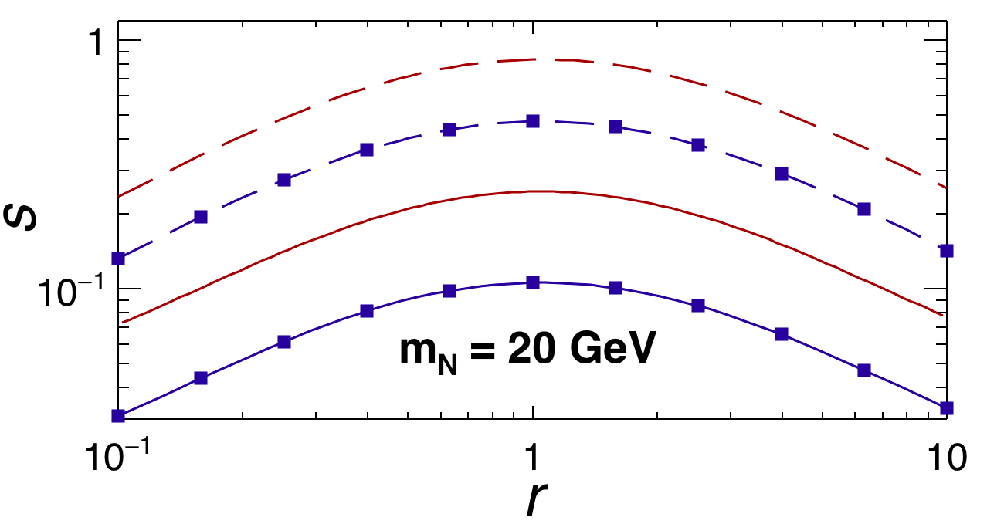
Introduction
3l+MET @ HL-LHC
2l+2j @ HL-LHC & SppC/FCC-hh
Summary
Sterile Neutrinos
Discovering/Excluding Majorana N
[our study: Phys.Rev. D95 (2017) no.11, 115020, cited by CMS collaboration ]
[LHC, CMS experiment: Phys.Rev.Lett. 120 (2018) no.22, 221801]
3000 fb⁻¹ (14 TeV)
Majorana N
5σ CC
0.24
3σ CC
0.11
0.08
5σ BDT
0.03
3σ BDT
when r = 1,
14 / 22
Notes:
3篇论文都已被LHC的CMS实验组关注和采纳 [Phys.Rev.Lett. 120 (2018) no.22, 221801]

Slide 15
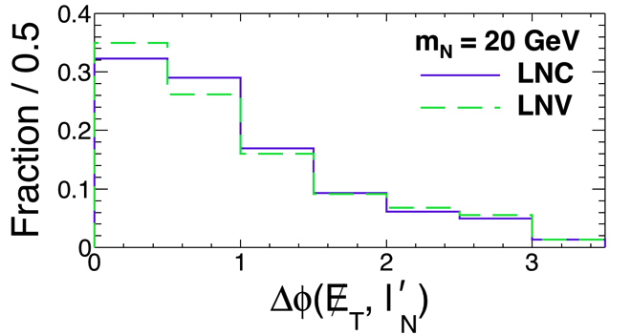
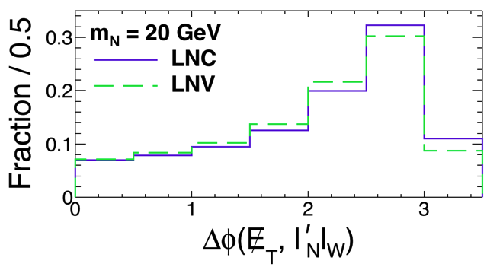
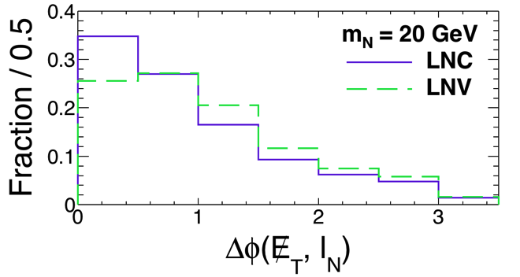
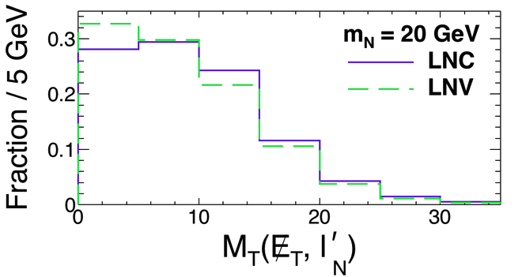
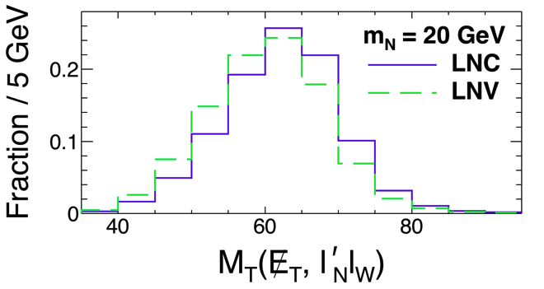
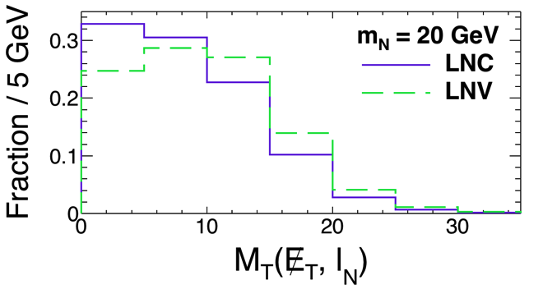
Introduction
3l+MET @ HL-LHC
2l+2j @ HL-LHC & SppC/FCC-hh
Summary
Distinguishing Dirac / Majorana
Basic Idea
(1) 1st MVA -> reduce SM BG
(2) 2nd MVA: exploiting kinematical distributions differing between LNC & LNV,
M_{T}(met, lep(s)) & Δφ(met, lep(s))
Input observables:
15 / 22

Slide 16
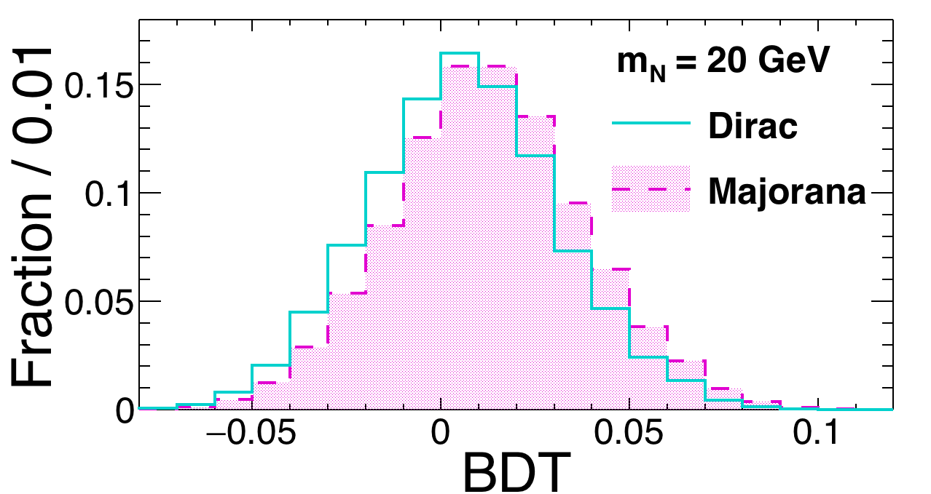
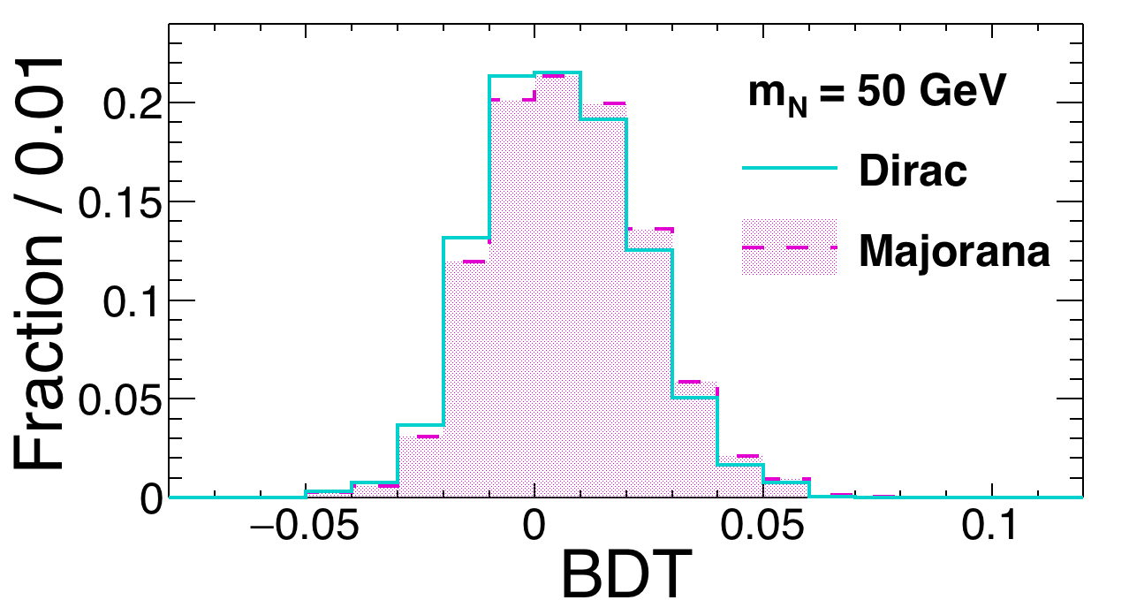
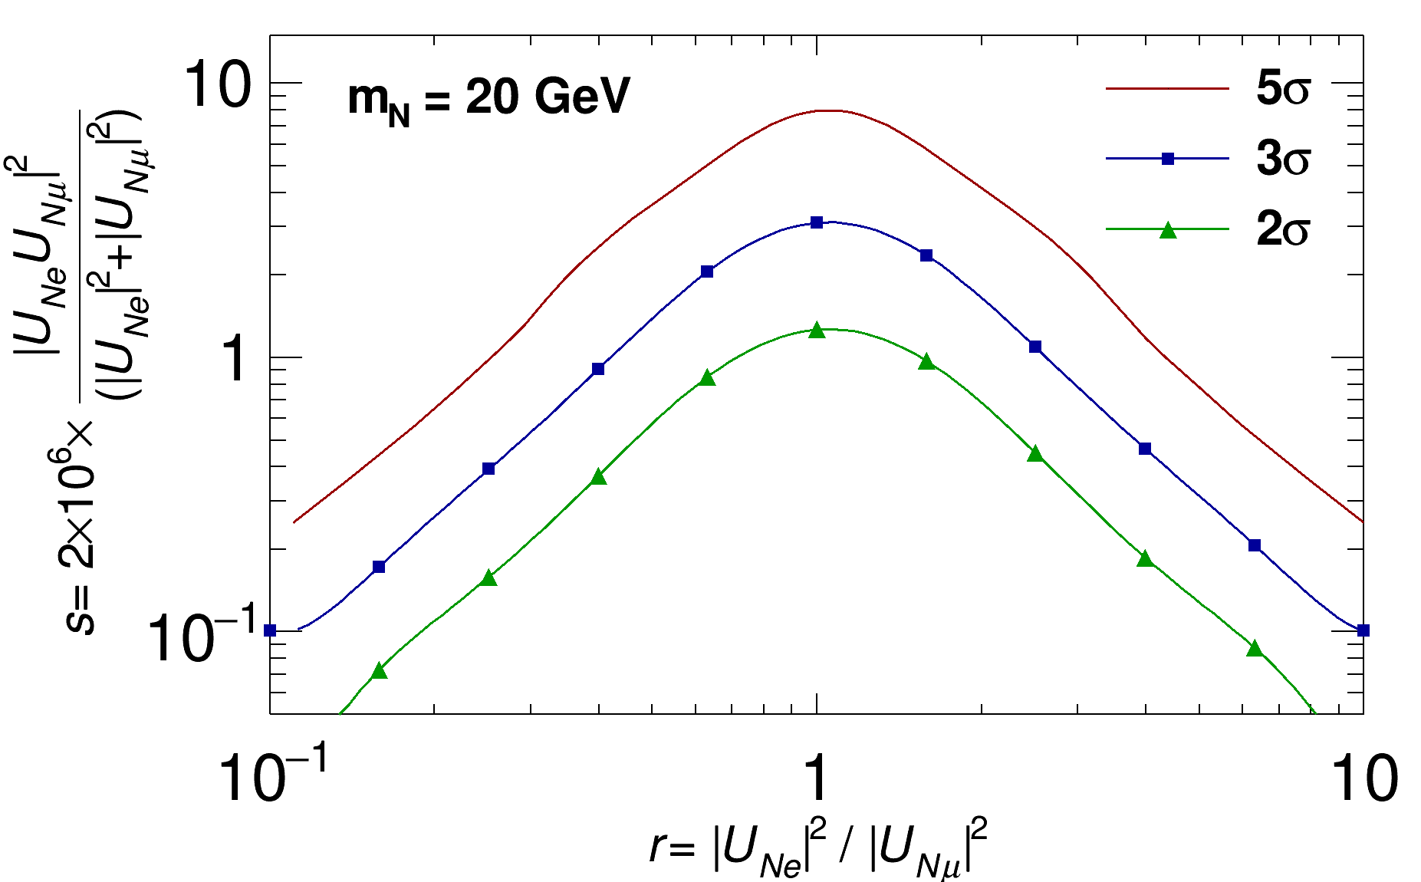
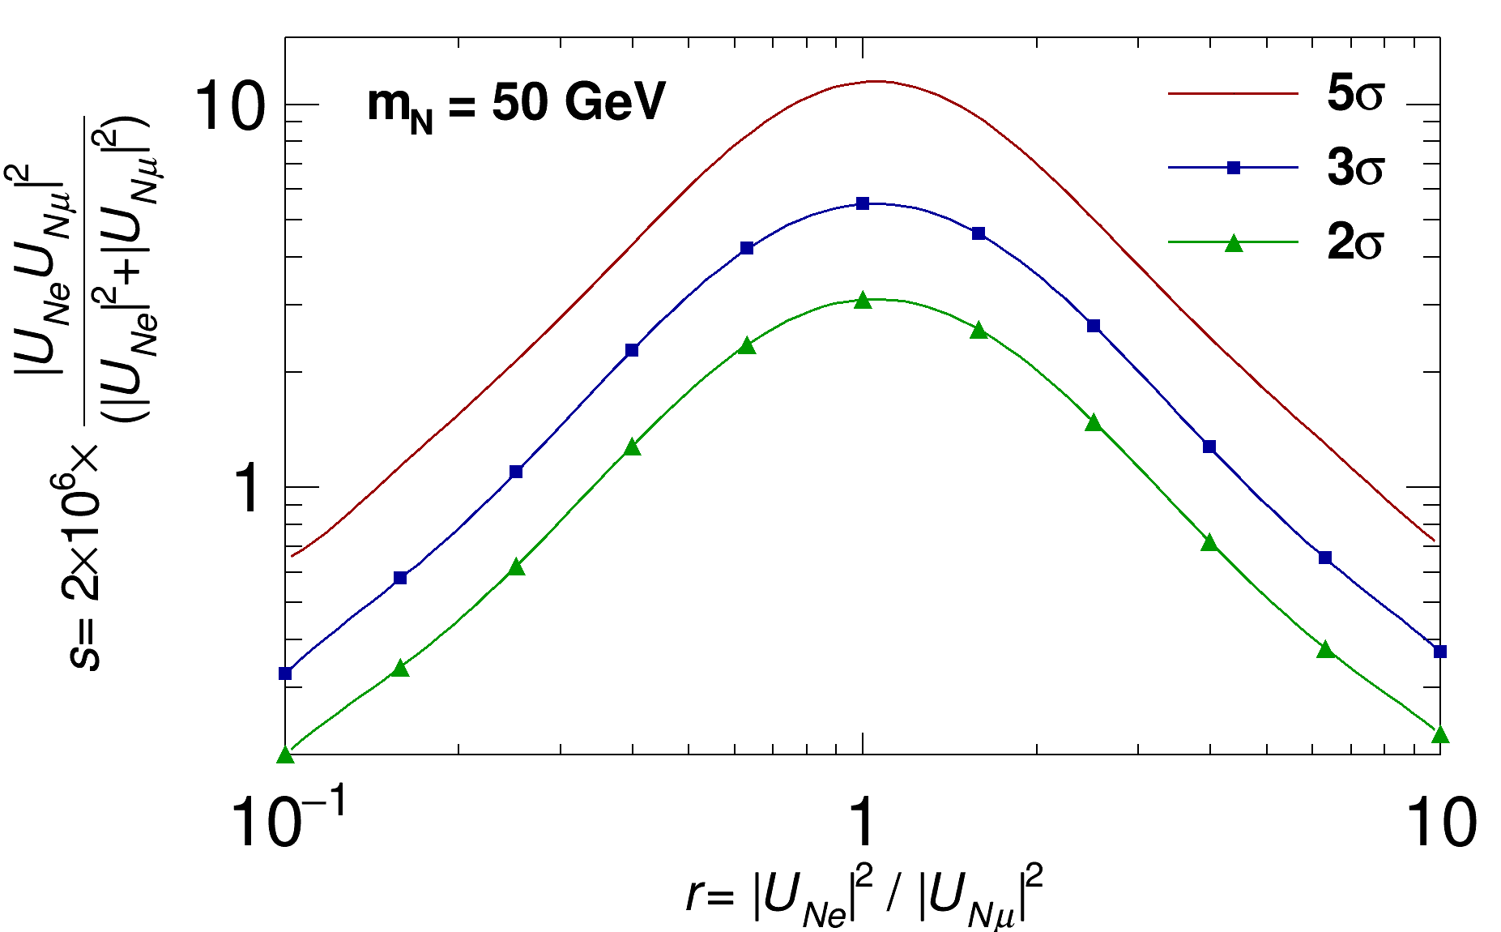
Introduction
3l+MET @ HL-LHC
2l+2j @ HL-LHC & SppC/FCC-hh
Summary
Distinguishing Limits
when r = 1,
7.93
11.44
3.10
5.47
0.25
0.72
0.10
0.38
16 / 22

Slide 17
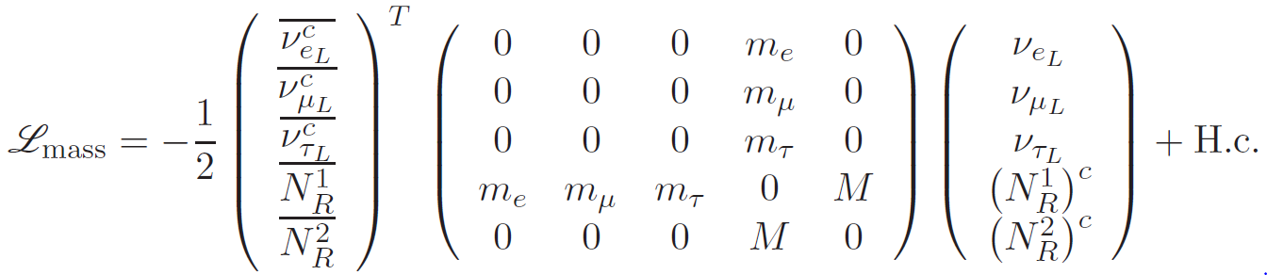
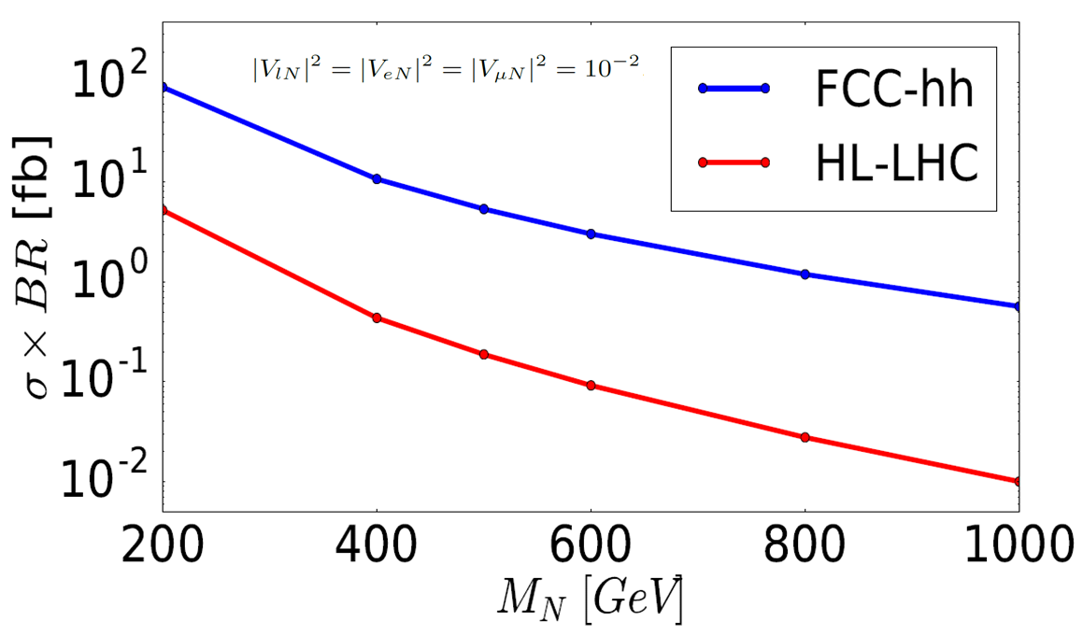
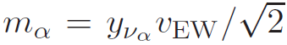
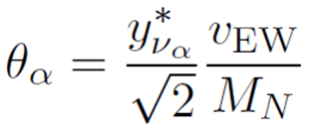
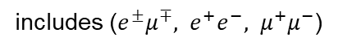
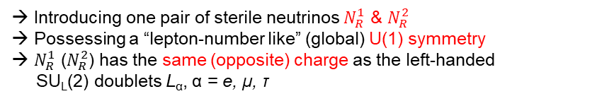
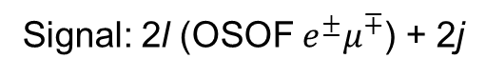
Introduction
3l+MET @ HL-LHC
2l+2j @ HL-LHC & SppC/FCC-hh
Summary
Signal in 2l+2j Final State
A symmetry protected seesaw model:
[S. Antusch, O. Fischer, JHEP 1505 (2015) 053]
Signal: 2l (OSOF $e^{±}μ^{∓}$) + 2j
→ when m_{N} > 200 GeV
→ Dirac N
→ Introducing one pair of sterile neutrinos $N_{R}^{1}$ & $N_{R}^{2}$
→ Possessing a “lepton-number like” (global) U(1) symmetry
→ $N_{R}^{1}$ ($N_{R}^{2}$) has the same (opposite) charge as the left-handed
SU_{L}(2) doublets L_{α}, α = e, μ, τ
Lagrangian density in the symmetric limit
Production cross section times branching ratio
After EWSB,
includes ($e^{±}μ^{∓}, e^{+}e^{−}, μ^{+}μ^{−}$)
Dirac masses
If exact symmetry,
→ Diagonalizing mass matrix
→ SM neutrinos get zero masses
→ (complex) active-sterile mixing parameters
If symmetry is slightly broken,
→ SM neutrinos achieve small masses
→ small mass “protected” by the symmetry -- technically natural
=> Mixing parameters & m_{N} can be free parameters in such models.
17 / 22

Slide 18

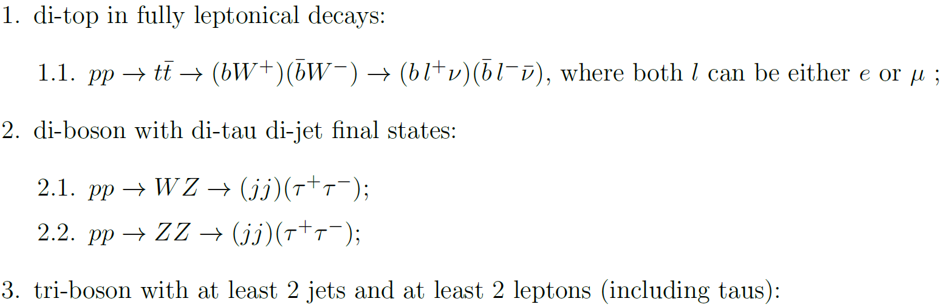
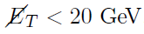
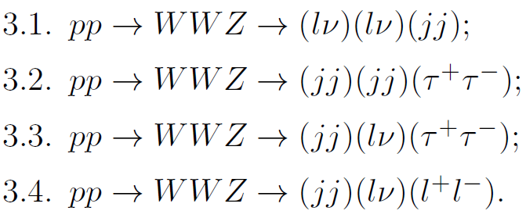
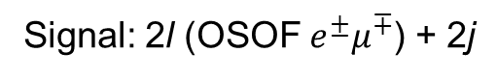
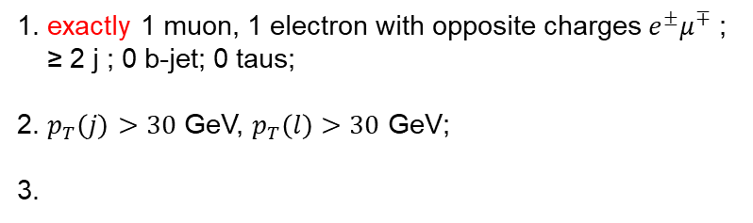
Introduction
3l+MET @ HL-LHC
2l+2j @ HL-LHC & SppC/FCC-hh
Summary
Signal: 2l (OSOF $e^{±}μ^{∓}$) + 2j
Simulation
MadGraph5 + Pythia6 + Delphes
SM Background:
2l + ≥ 2 j final state
→ with additional light neutrinos,
→ di-tau with both tau’s decaying leptonically
Pre-selection cuts
1. exactly 1 muon, 1 electron with opposite charges $e^{±}μ^{∓}$ ;
≥ 2 j ; 0 b-jet; 0 taus;
2. $p_{T}\left(j\right)>30$ GeV, $p_{T}\left(l\right)>30$ GeV;
3.
Strategy
→ Identifying correct lepton from N decay
→ Constructing various observables
→ Input observables to perform MVA-BDT analysis
3 leptons, contribute if one lepton is undetected
18 / 22
Notes:
Identifying correct lepton from N decay: on-shell mass of N

Slide 19



Introduction
3l+MET @ HL-LHC
2l+2j @ HL-LHC & SppC/FCC-hh
Summary
Input Observables at FCC-hh
Signal:
M_{N} = 500 GeV
19 / 22

Slide 20



Introduction
3l+MET @ HL-LHC
2l+2j @ HL-LHC & SppC/FCC-hh
Summary
BDT Analysis
Signal: M_{N} = 500 GeV
Cut flow table at FCC-hh, 20 ab⁻¹
# of events for signal with ${\left|V_{lN}\right|}^{2}={10}^{−2}$ & background
20 / 22

Slide 21








Introduction
3l+MET @ HL-LHC
2l+2j @ HL-LHC & SppC/FCC-hh
Summary
limits on ${\left|V_{lN}\right|}^{2}$
Expected median limits with/without sys. unc. on background
lum. = 20 ab⁻¹
$\sqrt{s}=100$ TeV
2 (5)-$σ$ limits on ${\left|V_{lN}\right|}^{2}$
M_{N} = 500 GeV
0% sys. unc. on B.
→ FCC-hh, 20 ab⁻¹
$7.0×{10}^{−5}$ ($1.9×{10}^{−4}$)
→ HL-LHC, 3 ab⁻¹
$4.9×{10}^{−3}$ ($1.7×{10}^{−2}$)
lum. = 3 ab⁻¹
$\sqrt{s}=14$ TeV
SYS(b) = 10%
SYS(b) = 0%
Expected limits with stat. unc. & 10% sys. unc. on background
21 / 22

Slide 22


Introduction
3l+MET @ HL-LHC
2l+2j @ HL-LHC & SppC/FCC-hh
Summary
Summary
MVA-BDT searches for Sterile neutrinos & charged Higgs at colliders
Sterile neutrinos from 3l+MET @ pp
→ $e^{±}e^{±}μ^{∓}/μ^{±}μ^{±}e^{∓}$ + MET
→ m_{N} = 20, 50 GeV @ 14 TeV LHC, 3 ab⁻¹;
→ 3 (5)-$σ$ limits on ${\left|V_{lN}\right|}^{2}$ for for m_{N} = 20 GeV with ${\left|V_{lN}\right|}^{2}={\left|V_{eN}\right|}^{2}={\left|V_{μN}\right|}^{2}$
2.5 (5.5)$×{10}^{−7}$ for Dirac N;
1.1 (2.4)$×{10}^{−7}$ for Majorana N;
3.1 (7.9)$×{10}^{−6}$ for distinguishing Dirac vs. Majorana
Sterile neutrinos from 2l + 2j @ pp
→ OSOF $e^{±}μ^{∓}$ + 2j for Dirac N
→ 2 (5)-$σ$ limits on ${\left|V_{lN}\right|}^{2}$ for m_{N} = 500 GeV with ${\left|V_{lN}\right|}^{2}={\left|V_{eN}\right|}^{2}={\left|V_{μN}\right|}^{2}$
$7.0×{10}^{−5}$ ($1.9×{10}^{−4}$) @ FCC-hh, 20 ab⁻¹
$4.9×{10}^{−3}$ ($1.7×{10}^{−2}$) @ HL-LHC, 3 ab⁻¹
22 / 22

Slide 23
Thanks for your attention!
23

Slide 24
Backup Slides
24

Slide 25
Mass Scales of m_{N}
m_{N}
⬥ Original Seesaw
⬥ Fits well with GUTs
⬥ Elegantly explains m_{ν}
⬥ Leptogenesis
→ Hard to test experimentally !
GUT
⬥ Inverse & Loop-induced SS
⬥ Leptogenesis
→ Testable at the LHC !
TeV
GeV
⬥ νMSM (Neutrino Minimal SM)
⬥ EW precisions, 0νββ, Leptogen.
→ Fine-tuned model but testable !
KeV
⬥ DM candidate (warm or cold)
⬥ X-ray bound (3.5 KeV line)
eV
⬥ neutrino oscillation & reactor/gallium anomaly
⬥ dark radiation
⬥ explain N_{eff} > 3
25

Slide 26

Global Constraints
from [Deppisch, Dev and Pilaftsis, New J. Phys. 17 (2015) 085019]
m_{N}: 0.1 ~ 500 GeV
26

Slide 27

Limits at Different Colliders
from [S. Antusch, E. Cazzato, O. Fischer, hep-ph/1612.02728 ]
27

Slide 28


Calculation vs. Simulation
Theoretical calculation
Simulation
m_{N} = 20 GeV
→ Distributions are verified by theoretical calculation
to make sure it is not just fluctuations.
28

Slide 29

Cut flow table at HL-LHC
# of events for signal with ${\left|V_{lN}\right|}^{2}={10}^{−2}$ & background, with lum. = 3 ab⁻¹
29

